Slide 1

Diabetes Risk Prediction
A Data-Driven Approach to Early Detection
Presented by: Lynette Ronnoh
Date: 18th November 2024

Slide 2

Project Background and Objective
Diabetes is a chronic metabolic disorder characterized by elevated blood glucose levels due to insufficient insulin production, impaired insulin action, or both.
Given the increasing prevalence of diabetes, early identification of at-risk individuals is crucial for timely intervention and better health outcomes.
The model will serve as a foundation for a telemedicine platform focused on early chronic illness detection examples: Hypertension, Asthma,Rheumatoid Arthritis, Neurological Disorders(epilepsy) and Cancer etc.
Objective
To develop a prediction model that assesses a patient’s risk of developing diabetes based on specific health metrics (age, gender, BMI, blood pressure, temperature, respiratory rate, pulse rate)

Slide 3





Contribution To
Sustainable Development Goals
SDG 3: Good health and well-being
By predicting diabetes risk early, healthcare providers can initiate timely interventions, reducing the risk of severe complications and enhancing overall community health.
SDG 9: Industry, Innovation, and Infrastructure
The project’s use of advanced data science techniques encourages innovation in healthcare technology, laying the groundwork for scalable, data-driven healthcare solutions.
SDG 10: Reduced Inequalities
Emphasizing equitable access to preventive healthcare through innovative technology.
‹#›

Slide 4

Business Questions
Can we accurately predict diabetes likelihood based on health metrics?
Which features are most predictive of diabetes?
How accurate is the model across different demographic groups?
What additional parameters can improve the model’s accuracy?

Slide 5
Data Understanding
Dataset: 32,779 patient records
Key Parameters: Age, gender, weight, height, blood pressure, pulse, temperature, respiratory rate, and pre-existing conditions (disease).

Slide 6


Data Exploration and Cleaning
Data Cleaning: Address missing values, detect outliers.
Feature Engineering: Create age_group, bmi_category, blood_pressure_category, and is_diabetes, is_hypertensive, and target column ‘diabetes_risk’

Slide 7
EDA
The data is mostly normally distributed.
The outliers are expected since the data is extracted from a hospital database where patients come in with extreme and unique conditions.
Records with patients with diabetes diagnosis were dropped to ensure that the model predicts for previously unknown/unconfirmed diabetes patients.

Slide 8
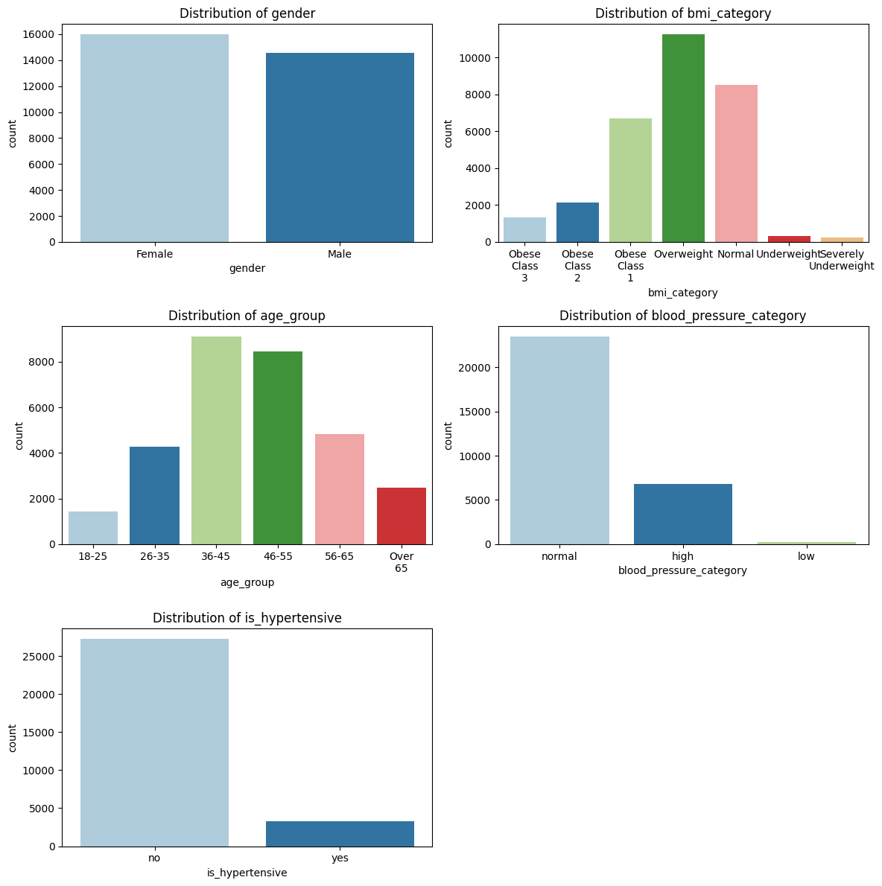
EDA (cont.)

Slide 9
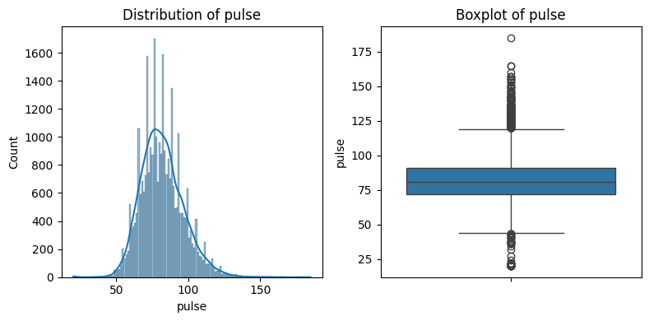
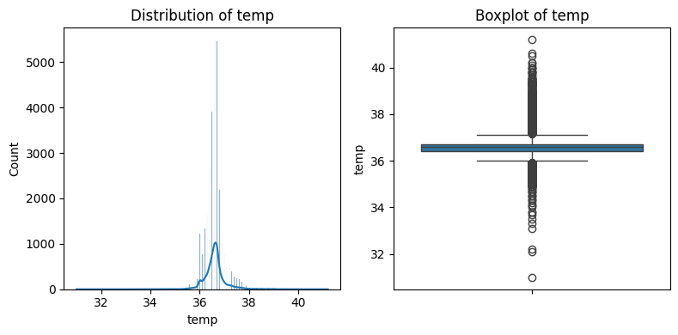
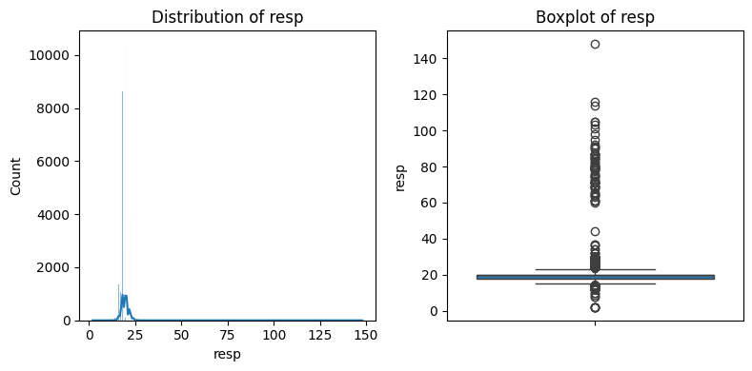
EDA (cont.)

Slide 10
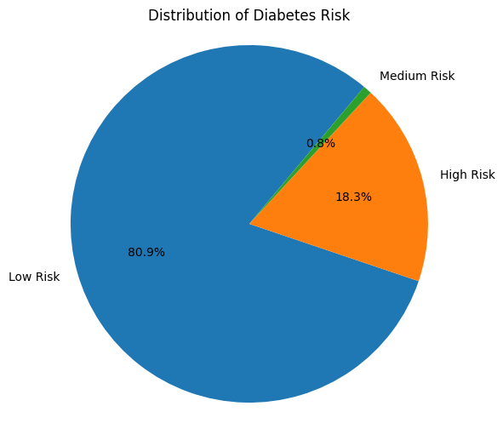
EDA (cont.)
Target: diabetes_risk
The class distributions (Low Risk, Medium Risk, High Risk) are significantly imbalanced.
Low Risk takes up the largest share (80.9%).

Slide 11
Modeling
Data Preprocessing: Categorical encoding, train-test split, SMOTE (Synthetic Minority Oversampling Technique) for class imbalance.
Models Used: Random Forest, Logistic Regression, XG-Boost.
Evaluation Metrics: Accuracy, precision, recall, F1-score.
Model Chosen: XG-Boost
Model Tuning: Tuned XG Boost
Feature Importance: blood pressure category, age group, hypertension.

Slide 12
Model Performance
Class | Metric | Random Forest | Logistic Regression | XG Boost Classifier
Accuracy |  | 99.39% | 93.86% | 99.46%
Low Risk | Precision | 100% | 99% | 100%
 | Recall | 99% | 93% | 100%
 | F1-Score | 100% | 96% | 100%
Medium Risk | Precision | 88% | 22% | 91%
 | Recall | 93% | 95% | 91%
 | F1-Score | 90% | 36% | 91%
High Risk | Precision | 98% | 87% | 98%
 | Recall | 99% | 96% | 99%
 | F1-Score | 99% | 91% | 99%

Slide 13
Model Summary
XG Boost performed the best at 99.46% accuracy. It performs highly in precision, recall, and F1-scores for all classes, especially the low-risk (0) and high-risk (2) classes, where precision and recall are close to 1.00.
Random Forest was also effective. It handles imbalanced classes better.
XG Boost performs significantly better than Random Forest and Logistic Regression in terms of precision (0.91) and recall (0.91) for the minority class (Medium Risk).

Slide 14
Tuned XG Boost
Recall for Medium Risk class increased from 91% to 93%, indicating better detection of medium-risk cases.
Accuracy dropped marginally from 99.46% to 99.41%, likely due to improved handling of the minority class (Class 1).
Minor decrease in recall for Class 0 (Low Risk), suggesting a slight shift towards favoring predictions for minority classes.
This is the chosen model due to its superior handling of all risk classes, particularly the challenging Medium-risk category

Slide 15
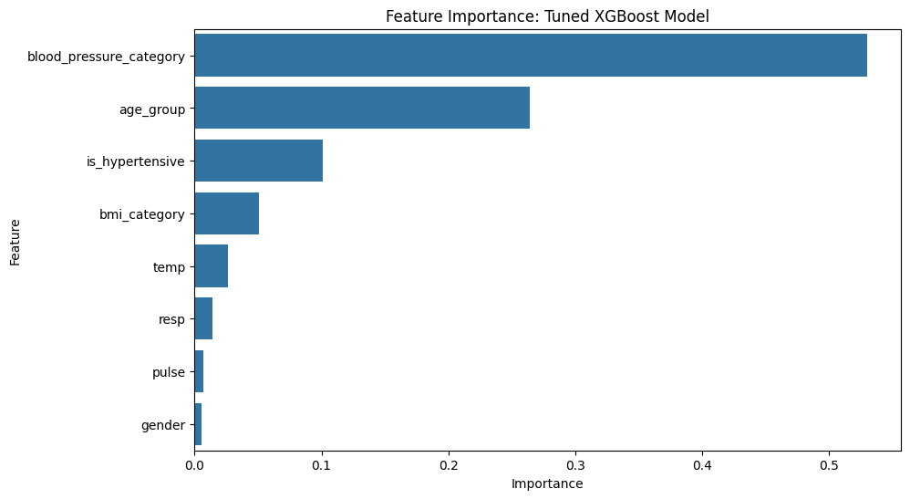
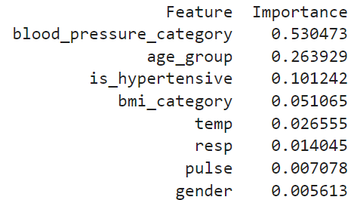
Feature Importance

Slide 16
Summary
XG Boost performed best despite the imbalanced dataset.
Blood Pressure has the most significant influence in the model's performance, followed by Age Group and whether the patient is Hypertensive.
Gender, Pulse Rate and Respiration Rate have the least influence.

Slide 17
Recommendations and Future Work
Further hyperparameter tuning, ensembles, and increasing the weight of the "Medium Risk" category may enhance model performance.
Future iterations should consider incorporating additional parameters during patient assessments. Specifically, including metrics such as random blood sugar levels and body fat percentage in the data collection interface can provide more comprehensive and indicative markers for diabetes risk.
Implement periodic retraining with fresh data to keep the model relevant as patient demographics evolve.
Work with both medical and non-medical stakeholders for guided industry applications.

Slide 18




THANK YOU!
Q & A

